Slide 1
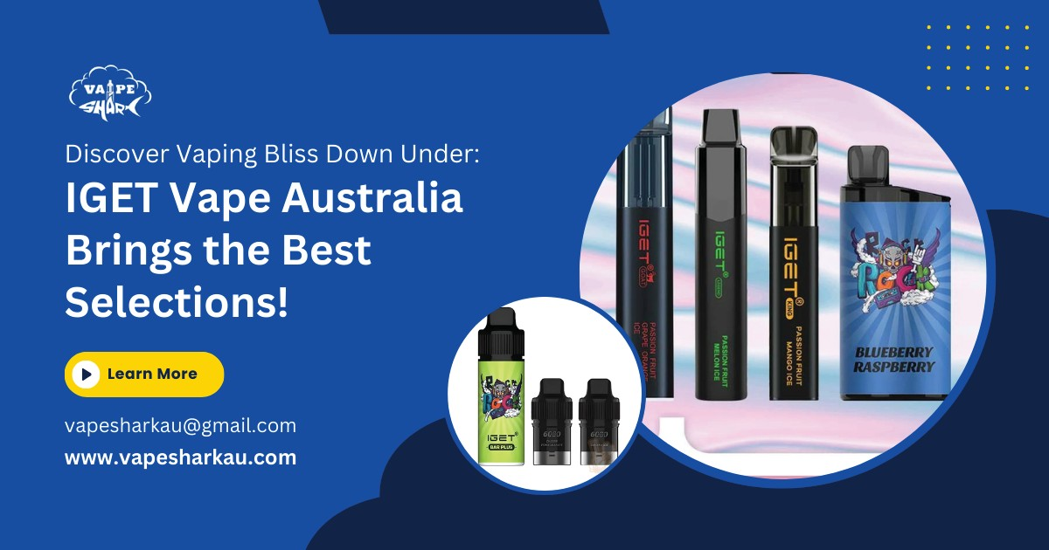
PRLog - Global Press Release Distribution
Discover Vaping Bliss Down Under: IGET Vape Australia Brings the Best Selections!
WANGARA, Australia - Feb. 13, 2024 - PRLog -- eading vaping company Vape Shark Australia is ecstatic to announce the introduction of IGET Vaped Australia, which promises fans all over the nation an unmatched experience.
IGET Vape Australia stands out as a leader in innovation and quality among the crowded market for vaping products. IGET Vape Australia aims to reimagine the vaping experience for Australians by delivering top-notch products and outstanding customer service.
Enhancing the vaping procedure
Australian vaping enthusiasts have long looked for a dependable source of high-quality products that suit their various preferences and tastes. IGET Vape Australia, a one-stop shop for all things vaping, is proudly introduced by vape Shark Australia in response to this need.
Customers are encouraged to explore IGET Vape Australia's wide selection of vaping devices, which range from sleek pod systems to potent box mods, in a welcoming and welcoming environment. Every vaping enthusiast will find something to suit their needs thanks to the meticulous selection of each product, which ensures superior performance, durability, and style.

Slide 2
PRLog - Global Press Release Distribution
A Gateway to Vaping Paradise
Diversity is celebrated and there are many options at IGET Vape Australia. Customers can choose from a variety of options to suit their preferences, whether they prefer the comfort of disposable vape pens or the potent flavors of e-liquids. To improve the vaping experience and keep devices running smoothly, the store also carries a wide variety of accessories, such as coils, tanks, and batteries.
According to John Smith, CEO of Vape Shark Australia, "Our goal is to give our customers access to the best vaping products available." We are committed to ensuring that Australians have access to high-end products that improve their experience because we recognize that for many of them, vaping is more than just a hobby.
Setting a New Standard for Excellence
IGET Vape Australia is proud to have established a new benchmark for excellence as the industry's forerunners. To ensure safety, dependability, and performance, each product goes through rigorous testing and quality assurance procedures. Additionally, the store's knowledgeable staff is available at all times to help customers find the ideal vaping setup by providing specialized guidance and recommendations.
Buy Now vape in Australia
visit IGET Vape Australia: https://vapesharkau.com/iget-vape-australia/
Contact
John Smith vapesharkau@gmail.com
+61 405393007
--- End ---
Source City/Town State/Province Country Industry
Tags Link
Vape Shark Australia Wangara
Western Australia Australia Lifestyle
IGET Vape Australia https://prlog.org/13006842
Scan this QR Code with your SmartPhone to-
Read this news online
Contact author
Bookmark or share online

