Slide 1

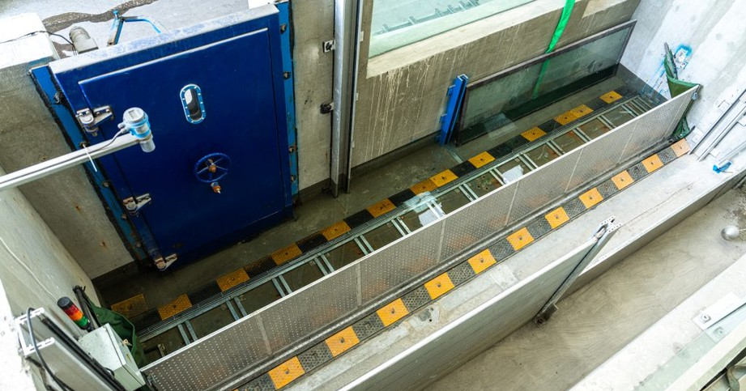
Common Mistakes to Avoid When Using a Flood Defense Barrier
WAITING UNTIL FLOODWATERS ARRIVE
Delaying the deployment of a Flood Defense Barrier leaves little time for proper installation. Always activate the barrier as soon as flood warnings are issued.
CHOOSING THE WRONG BARRIER
Every property has unique flood risks. Selecting the correct barrier size, height, and design is essential for complete protection.
IMPROPER INSTALLATION
Incorrect positioning, loose locking mechanisms, or poor sealing can allow water to seep through. Always follow the manufacturer's installation guidelines.
IGNORING REGULAR MAINTENANCE
Dirt, rust, damaged seals, and worn components can reduce the barrier's effectiveness. Schedule routine inspections and maintenance to ensure reliable performance.
OVERLOOKING DRAINAGE SYSTEMS
A Flood Defense Barrier works best when combined with efficient drainage and water management systems that prevent excessive water buildup.
LACK OF EMERGENCY TRAINING
Employees or family members should know how to operate the barrier quickly and correctly during emergencies to minimize response time.
Read More
www.flooddefend.com/product/fully -automatic-underground-garage-flood-barrier

Slide 2
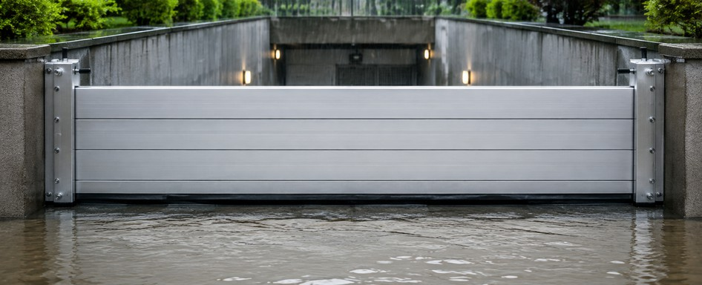
Newflag Technology Co., Ltd. introduces a Flood Defense Barrier built specifically for garage entrances and underground parking areas—designed to protect vehicles and property when water levels rise quickly. This fully automatic, water-driven flood barrier uses hydrodynamic action: as floodwater accumulates, buoyancy lifts the floating barrier panel to block water automatically. When the water recedes, the panel closes back down in sync with the changing water level. No electricity and no manual intervention are required, helping the barrier stay reliable even during outages or after-hours emergencies.
Why a Flood Defense Barrier Matters for Garages
Garages are often located below street level, making them vulnerable to stormwater runoff, surface flooding, and sewage backflow. Even short-duration flooding can lead to structural issues, electrical damage, vehicle loss, and long downtime. A responsive Flood Defense Barrier reduces that risk by creating dependable water blocking at the doorway.
Common Mistakes to Avoid
Waiting Until Floodwaters Arrive
Delaying the deployment of a Flood Defense Barrier leaves little time for proper installation. Always activate the barrier as soon as flood warnings are issued.
Choosing the Wrong Barrier
Every property has unique flood risks. Selecting the correct barrier size, height, and design is essential for complete protection.
Improper Installation
Incorrect positioning, loose locking mechanisms, or poor sealing can allow water to seep through. Always follow the manufacturer's installation guidelines.
Ignoring Regular Maintenance
Dirt, rust, damaged seals, and worn components can reduce the barrier's effectiveness. Schedule routine inspections and maintenance to ensure reliable performance.
Overlooking Drainage Systems
A Flood Defense Barrier works best when combined with efficient drainage and water management systems that prevent excessive water buildup.
Lack of Emergency Training
Employees or family members should know how to operate the barrier quickly and correctly during emergencies to minimize response time.
Skipping Routine Testing
Conduct periodic operational tests to verify that automatic or manual systems function properly before the flood season begins.

Slide 3

Protect Your Property with Reliable Solutions
A Flood Defense Barrier is a critical component of any flood preparedness strategy, but its success depends on proper planning, installation, and maintenance. By avoiding these common mistakes, property owners can significantly improve flood protection and reduce the risk of costly water damage. Newflag Technology Co., Ltd. delivers innovative, durable, and easy-to-operate flood barrier systems that provide long-lasting performance for underground garages, commercial buildings, industrial facilities, and other flood-prone areas, ensuring dependable protection when it matters most.
Visit here https://tinyurl.com/y c57u7b2 for more details about Flood Defense Barrier, or email us at lucy@newflagtech.com and give us a call at +86 18961628536 today!

